Slide 1
SAVEETHA SCHOOL OF ENGINEERING SAVEETHA INSTITUTE OF MEDICAL AND TECHNICAL SCIENCES EMPLOYEE MANAGEMENT SYSTEM
Submitted by
Varun kuamr
(192110128)
Department of CSE
Saveetha School of Engineering
SIMATS, Chennai –602105
project Guide
Dr.Bhuvanshwari
Professor
Department of CSE
Saveetha School of Engineering
SIMATS, Chennai –602105

Slide 2
KEY COMPONENTS
Abstract.
Introduction.
Software requirements.
Existing Work.
Proposed.
Use Case Diagram.
Technology Used.
Output.
Conclusion.
Future enhancement.
References

Slide 3
ABSTRACT
Employee Management System Project is an essentially software designed to keep track of employee information in any company. It stores data such as their employees' personal information. The goal of "Employee Management System" is to create a work center scheduling system. Scheduling is a technology that makes the process of informing activities and notifications in the company where it is implemented simple and even online.
The employee management system project gives managers a better idea of their employees and helps them plan and manage their work hours to cut costs and boost productivity. It gives appropriate directions and supervisions for employees.

Slide 4
INTRODUCTION
Employee management systems offer a comprehensive solution for organizations to efficiently manage their resources. A key feature of these systems is time tracking for employees, which plays a pivotal role in optimizing operations.
Time tracking functionality within employee management systems enables organizations to accurately monitor the time spent by employees on various tasks and projects. This allows managers to gain insights into how time is allocated across different activities, identify areas of inefficiency, and make informed decisions to streamline processes.
Overall, time tracking is a fundamental feature of employee management systems that not only helps organizations better manage their resources but also promotes efficiency, accountability, and transparency across the organization. By leveraging the insights gained from time-tracking data, organizations can optimize their operations, improve productivity, and achieve their business objectives more effectively.

Slide 5
Software requirements
Employee Database Management: Maintain a centralized database containing detailed information about all employees, including personal details, contact information, job roles, and employment history.
Design: Umbrello software isusedto develop theusecasediagramfor employee Management System . Swingcomponents….. suchasJFrame,JPanel,JButton,etc.,will be utilizedfor building interactiveinterfacesfor Employee Management System.
JDK- JDK or Java Development Kit is basically a bridge of one of the platform of java, enterprise edition, or java platform. It also has a private form of JVM and few different resources in order to finish the full development of the java application. It is one of the most used SDK since the origin of java.
JRE- JRE or Java Runtime Environment, this is also called as java runtime. It is a set of tools for developing java applications, this is also a part of the java development kit. It also provides the user

Slide 6
EXISTING WORK
Data Fragmentation: Employee data may be scattered across multiple systems or stored in disparate formats, making it challenging to access and consolidate information for decision-making purposes.
ADP Workforce Now is a comprehensive human capital management solution designed for medium to large businesses. It includes features such as payroll processing, benefits administration, talent management, time and attendance tracking, and compliance management.
Lack of Integration: Siloed systems for different HR functions, such as payroll, performance management, and training, often lack seamless integration, resulting in data duplication, inconsistencies, and disjointed workflows.

Slide 7
Proposed work
Employee Login:
Create a secure authentication system for employees to log in.
Use techniques such as username/password authentication or multi-factor authentication for enhanced security.
Implement session management to handle user sessions securely. Define user roles and permissions to control access levels within the system.
Add an Employee:
Implement a feature to add a new employee to the system.
Gather necessary information such as name, contact details, department, position, etc.
Delete an Employee:
Allow authorized users (e.g., administrators) to delete an employee from the system.
Implement appropriate confirmation prompts to prevent accidental deletions.

Slide 8
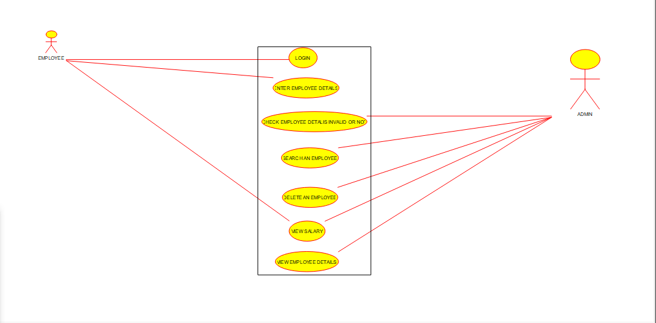
USECASE DIAGRAM

Slide 9
Technology Used
The Employee Management System, implemented with Java Swing technology, offers a robust and user-friendly solution for efficiently managing employee-related tasks in various organizational settings. Java Swing provides a platform-independent graphical user interface (GUI) toolkit, ensuring accessibility and consistency across different operating systems.
This system utilizes Java Swing components to create an intuitive and interactive interface, enabling administrators or managers to navigate and perform employee management tasks with ease. The use of JFrame, JPanel, JButton, and other Swing components ensures a visually appealing and responsive user experience.

Slide 10
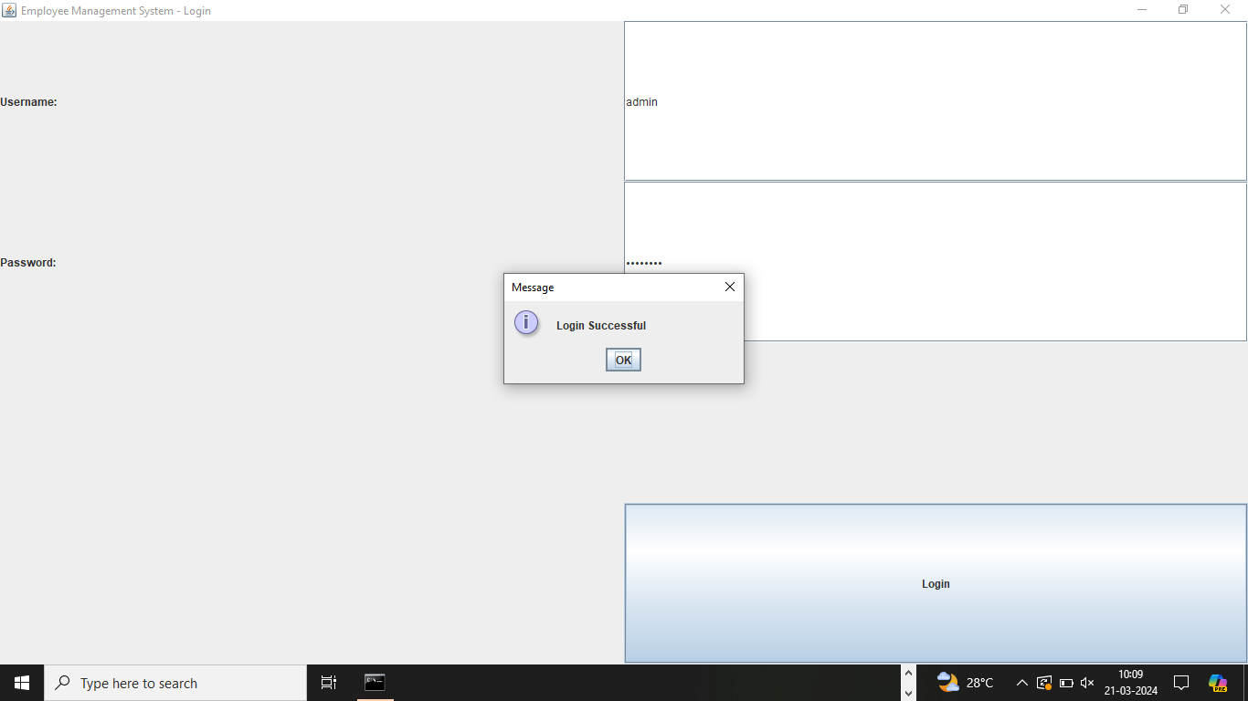
Outputs:

Slide 11
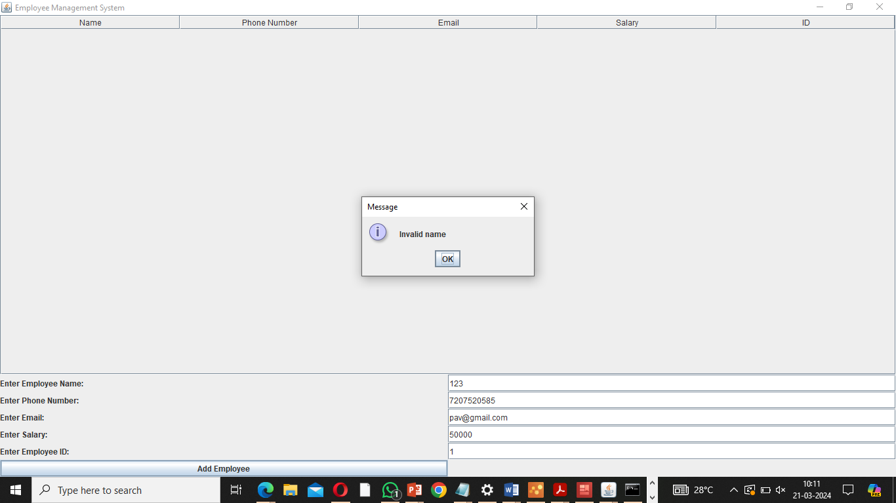

Slide 12
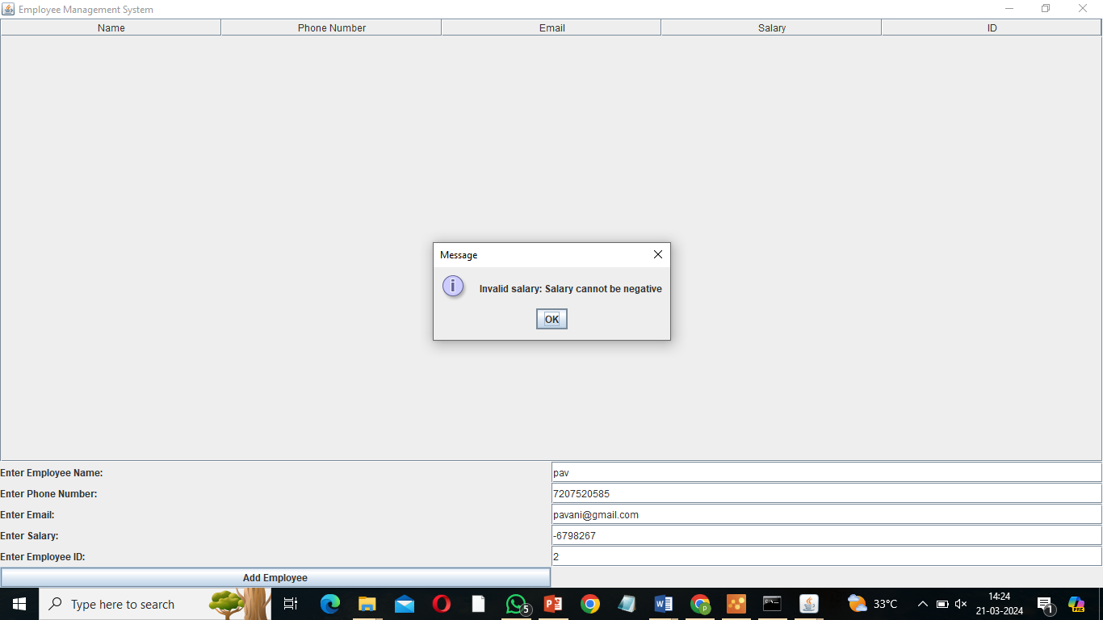

Slide 13
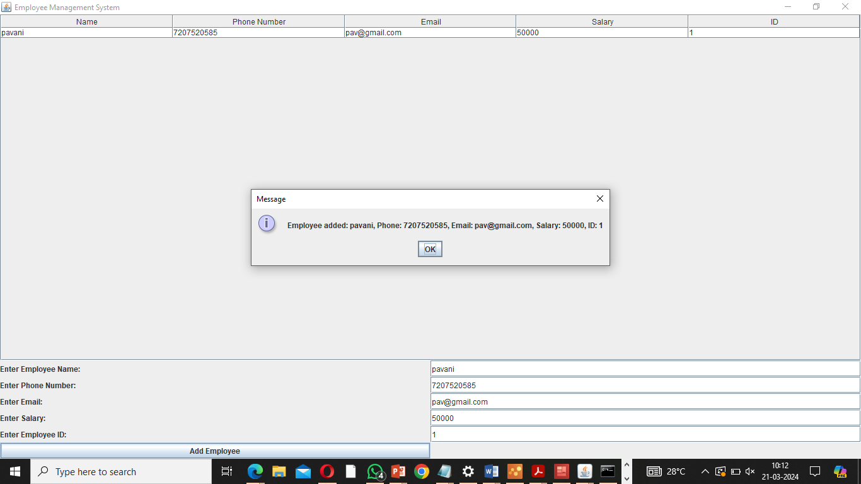

Slide 14
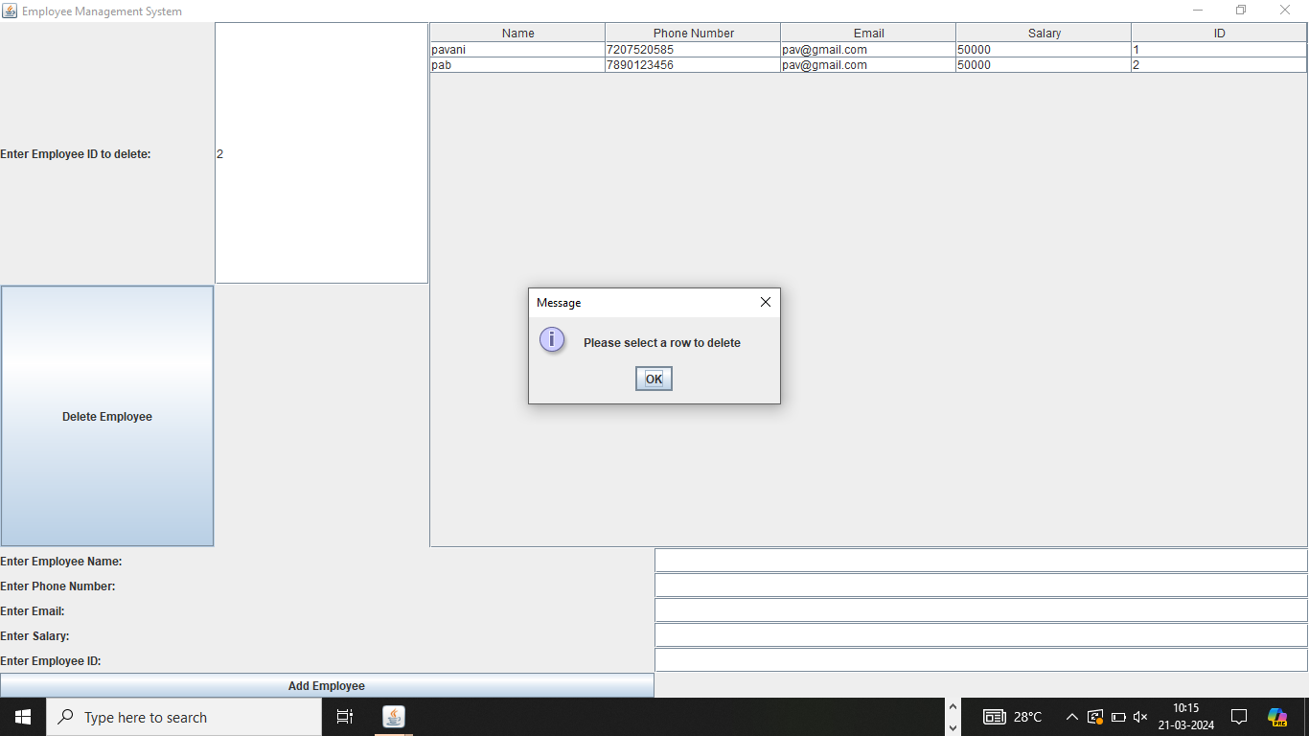

Slide 15


Slide 16
Conclusion
The Employee Management System is a Java Swing application designed to manage employee information such as names, IDs, emails, salaries, attendance, and profile images. It allows users to add, edit, delete, search, view salary, and view detailed information about employees.
The application provides a user-friendly interface with input fields, buttons for various operations, and a table to display employee data. It utilizes event-driven programming to handle user interactions and updates the user interface accordingly.
The system incorporates features like uploading profile images, calculating attendance based on clock in/out times, overtime, and absences, and displaying employee details in a separate window.

Slide 17
Future enhancement
Explore the integration of Internet of Things (IoT) devices for more comprehensive and context-aware attendance tracking, allowing for additional data points and insights. Implement machine learning algorithms to analyze historical attendance data and predict future attendance trends, enabling proactive management strategies.
Further develop and optimize the mobile application, providing additional features such as geolocation-based attendance marking for field-based employees.
Investigate the use of blockchain technology to enhance the security of attendance records, ensuring tamper-proof and transparent data management. Integrate the Employee Management System with smart office technologies for a cohesive workplace experience, including automated room access based on attendance.

Slide 18
REFERENCES
https://projectgurukul.org/java-employee-management-system/SourceForge: Employee Management System Projects
https://copyassignment.com/employee-management-system-project-in-java/
https://codewithcurious.com/projects/empolyee-managment-system-using-python/
https://code-projects.org/simple-employee-management-system-in-java-with-source-code/
https://github.com/PrathameshDhande22/Employee-Management-System.

Slide 19


